Slide 1
BHARAT HEAVY ELECTRICALS LIMITED - HPBP, TRICHY
MATERIALS MANAGEMENT - DISPOSAL STORES
SCRAP MATERIAL – PICTURES
Unusable/ Unidentified Ferrous Tubes (Excluding SS Tubes)
Disclaimer: Buyers are requested / advised to inspect the lots physically and make assessment / judgment of the scrap material details provide in these pictures. BHEL Trichy shall not be liable for any error in judgment made by the buyer in this regard.

Slide 2
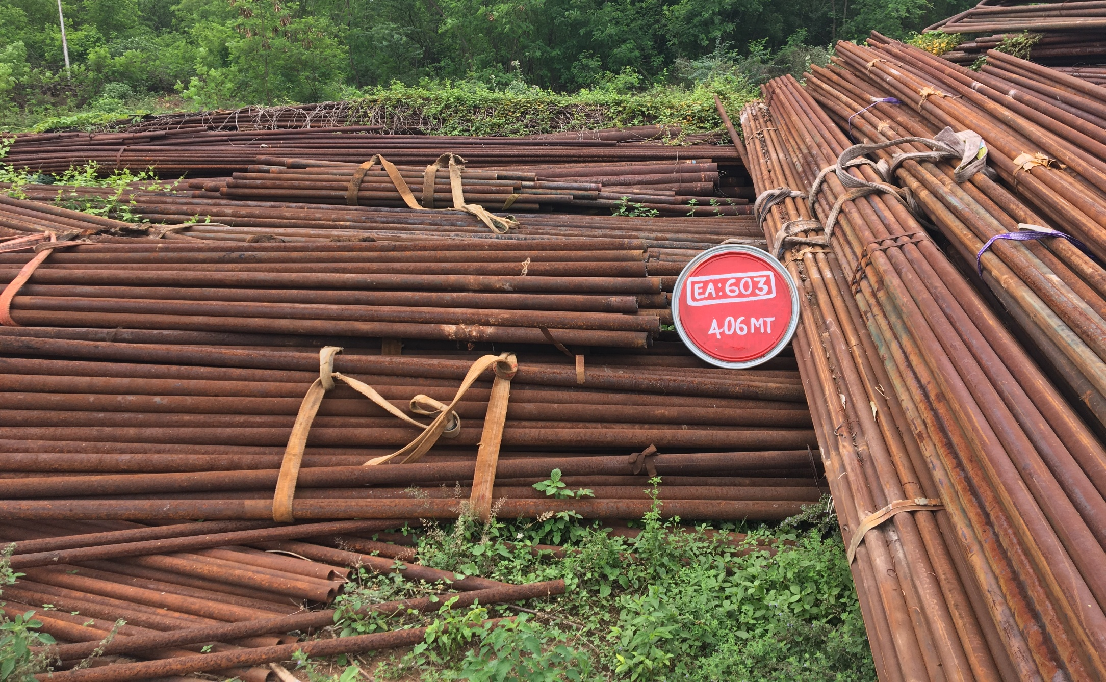
Location : Near BARC Store

