Slide 1
BHARAT HEAVY ELECTRICALS LIMITED - HPBP, TRICHY
MATERIALS MANAGEMENT - DISPOSAL STORES
SCRAP MATERIAL – PICTURES
Lot No. A1
Assorted grade rolled plates / sheets of various sizes (including cut-bits and balance plates/sheets after profile cutting) with / without deformed condition (excluding SS materials) on as is where is basis.
Disclaimer: Buyers are requested / advised to inspect the lots physically and make assessment / judgment of the scrap material details provide in these pictures. BHEL Trichy shall not be liable for any error in judgment made by the buyer in this regard.

Slide 2
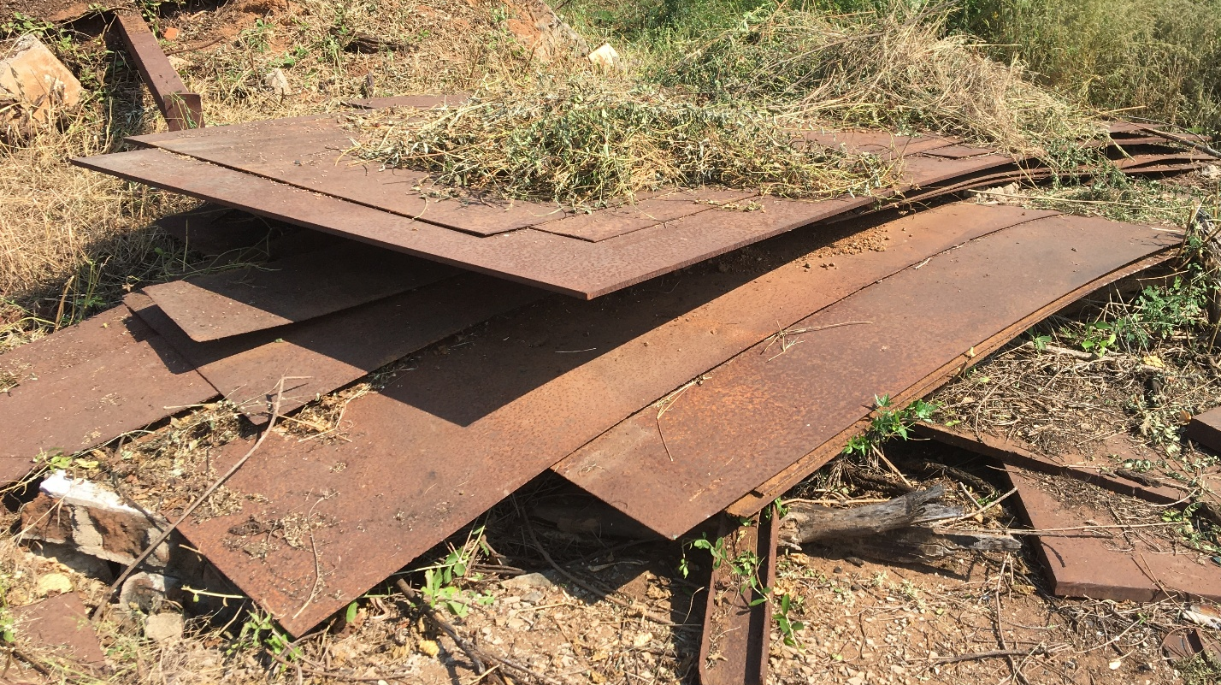
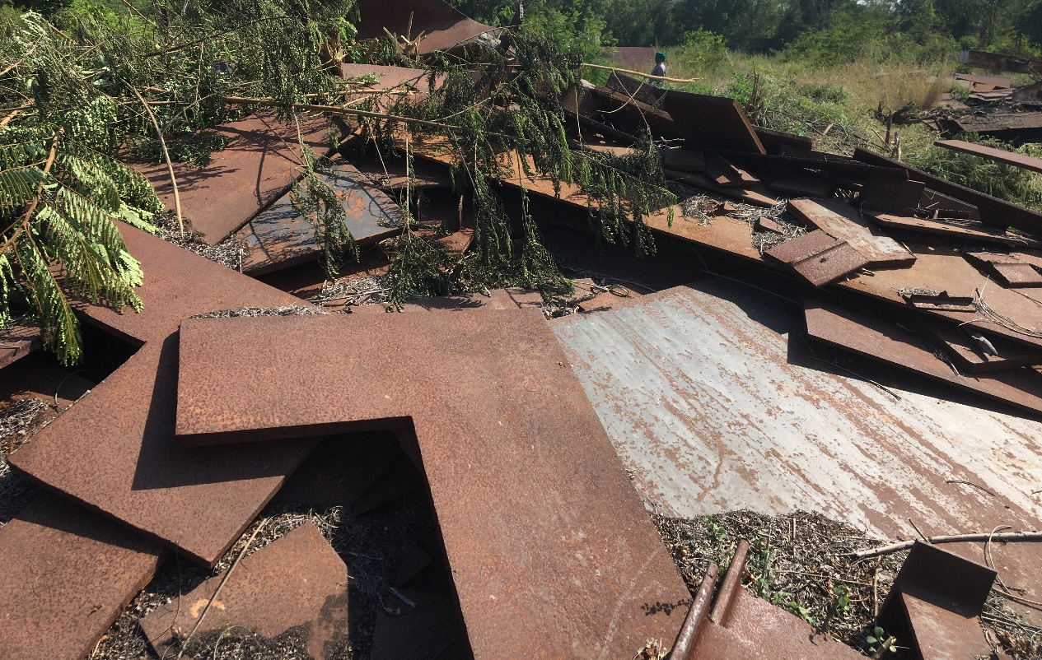
Location inside RPS – a). South end of the road in between Bay - 1 & 2. b) Bay - 2D & c) South End high mass light (near production centre)

Slide 3
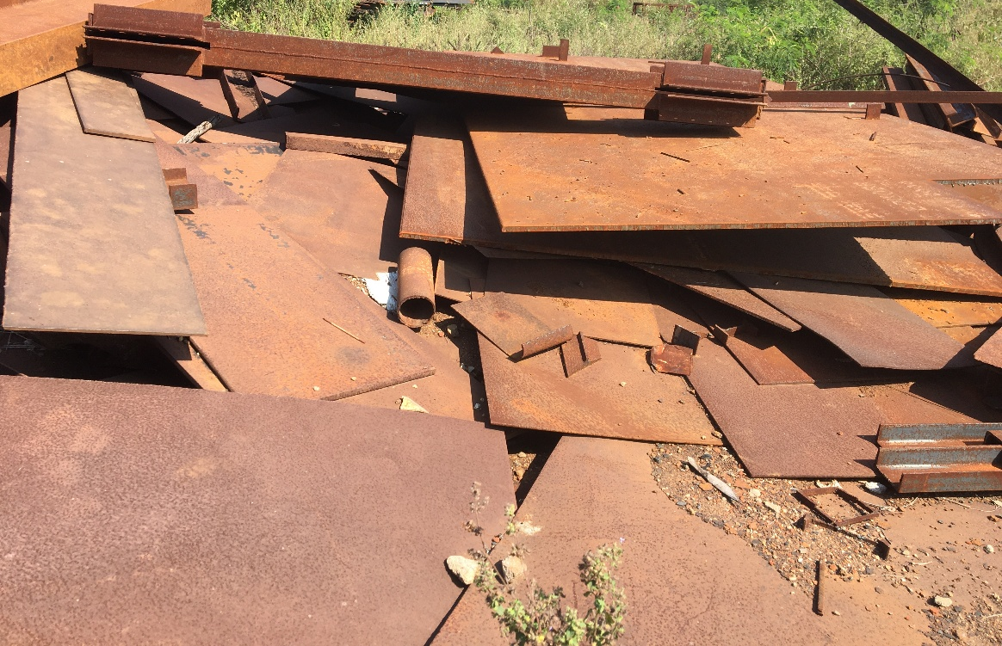
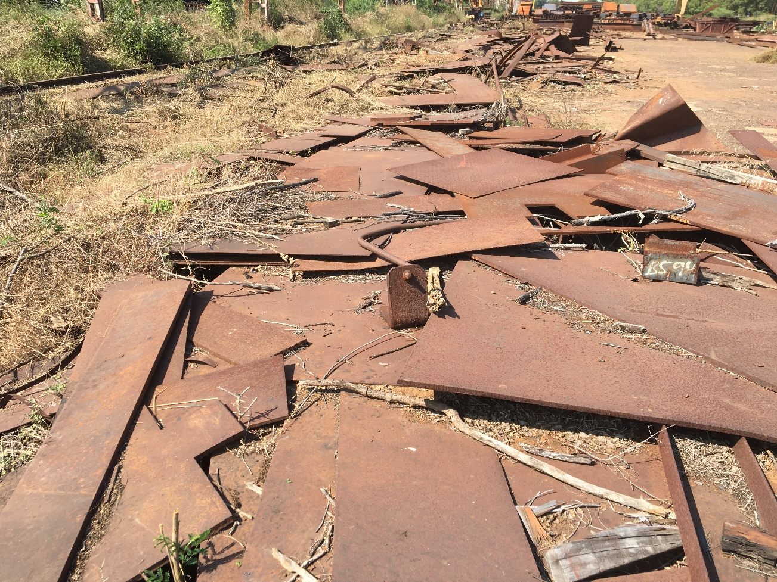
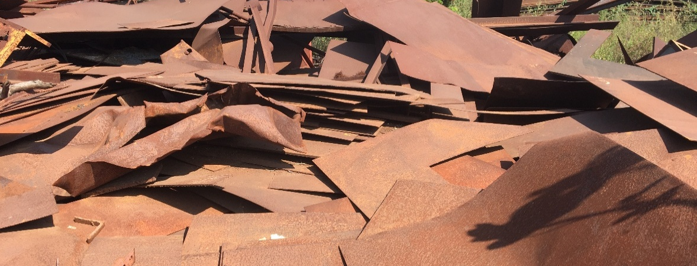
Location inside RPS – a). South end of the road in between Bay - 1 & 2. b) Bay - 2D & c) South End high mass light (near production centre)

Slide 4
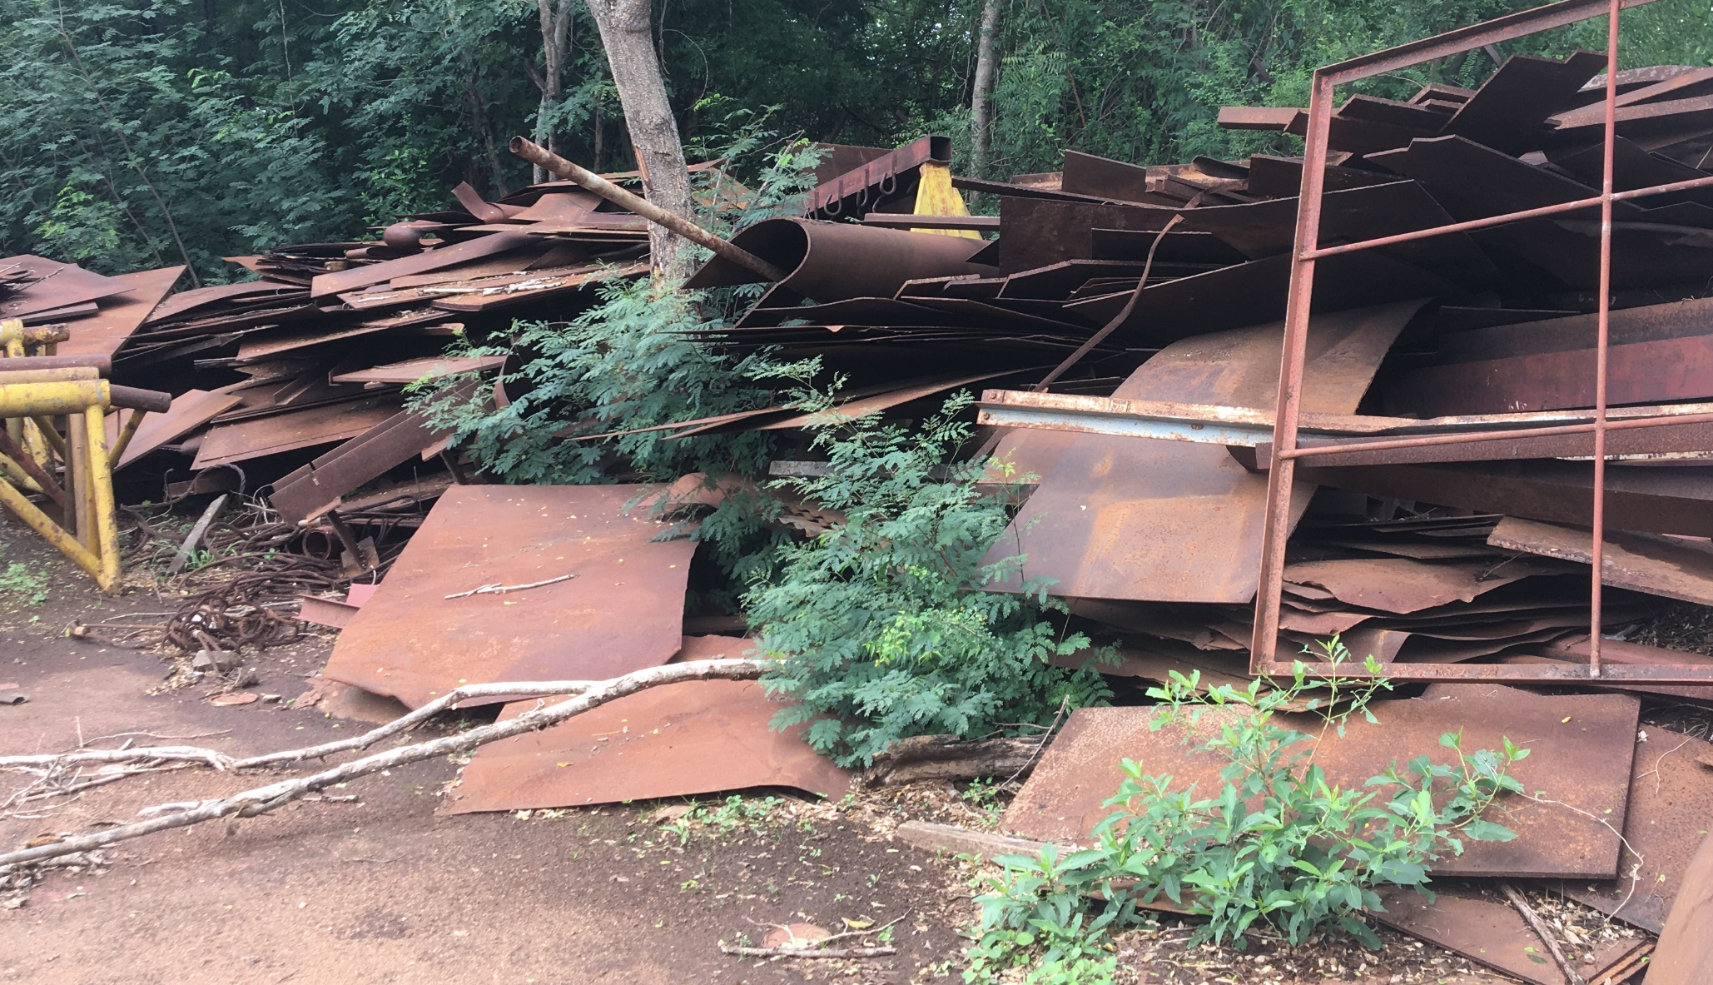
Location inside RPS – a). South end of the road in between Bay - 1 & 2. b) Bay - 2D & c) South End high mass light (near production centre)

