Slide 1
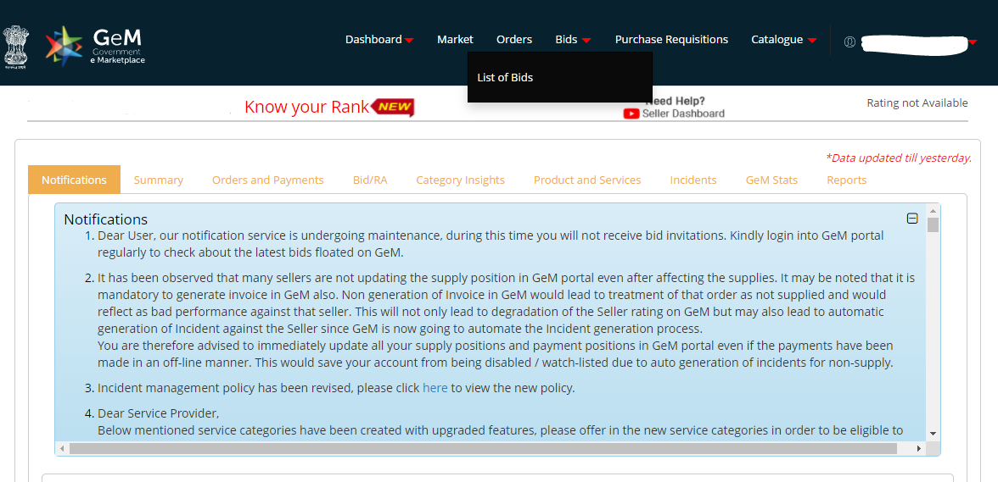
Log in and click on Bids and select list of bids

Slide 2
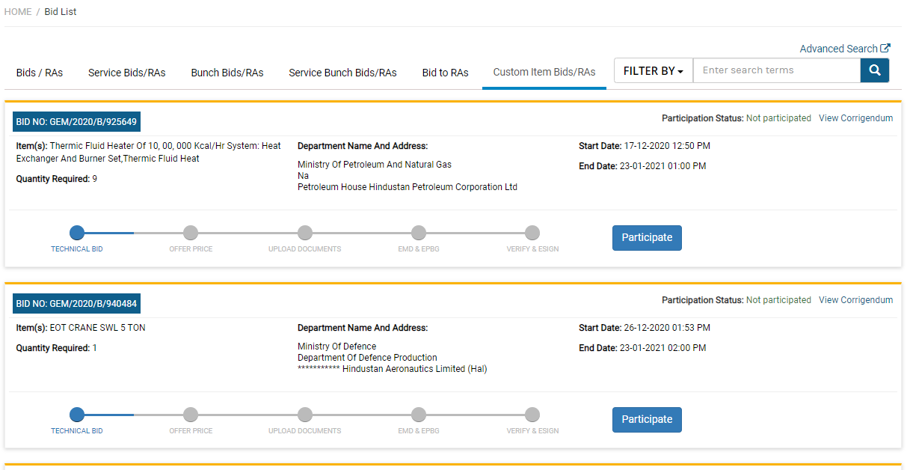
Select the header Custom Item Bids / RA

Slide 3
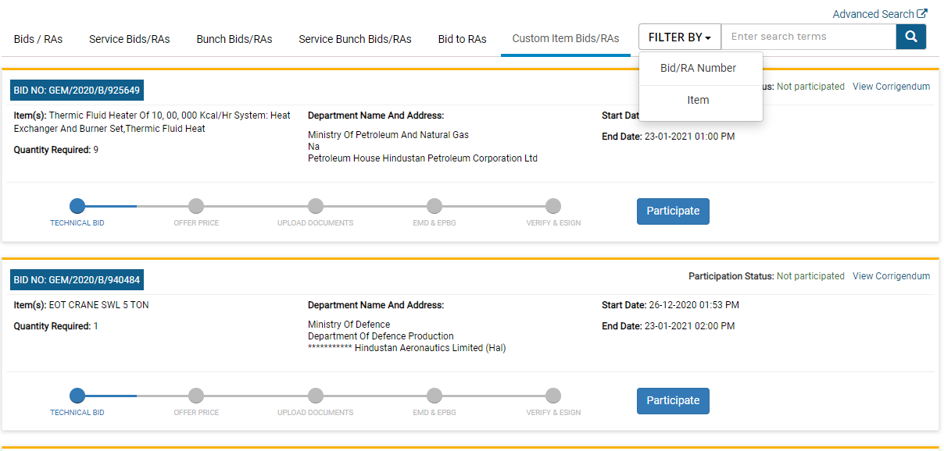
Select the filtering option Bid / RA number

Slide 4
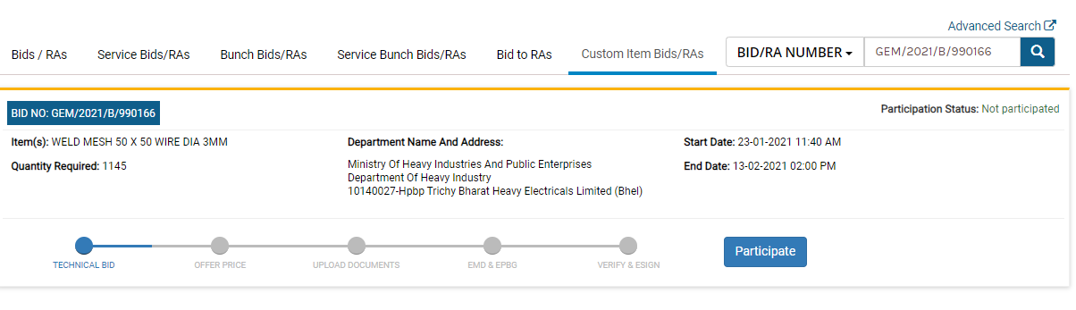
Enter the Bid no and search.
Click the participate link

Slide 5
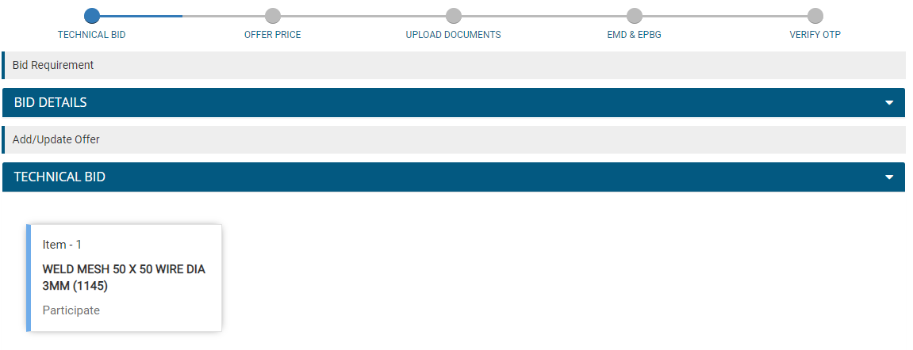
Click the link to participate

Slide 6
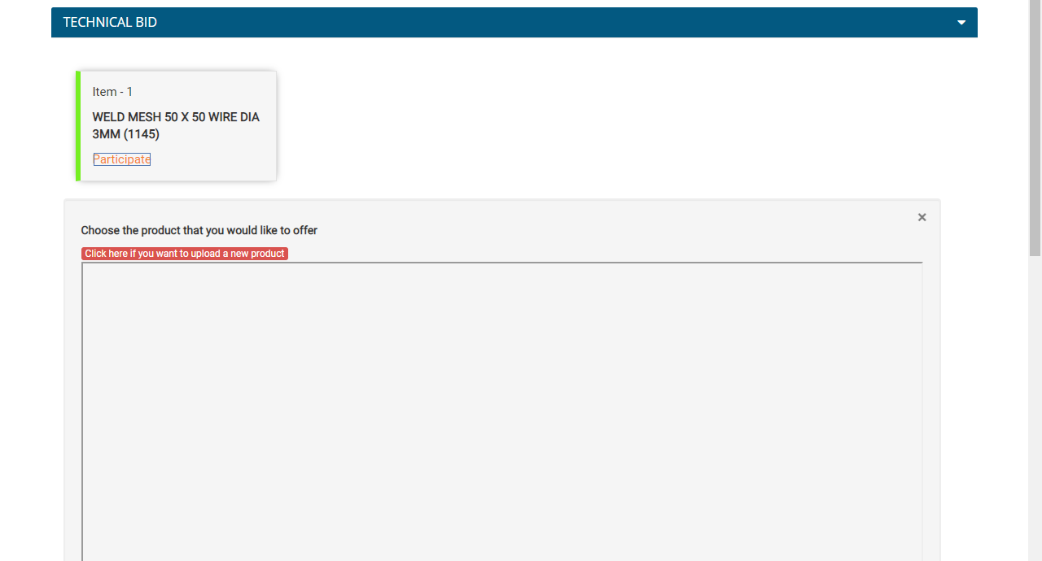
Click the link highlighted in red to add catalogue

Slide 7
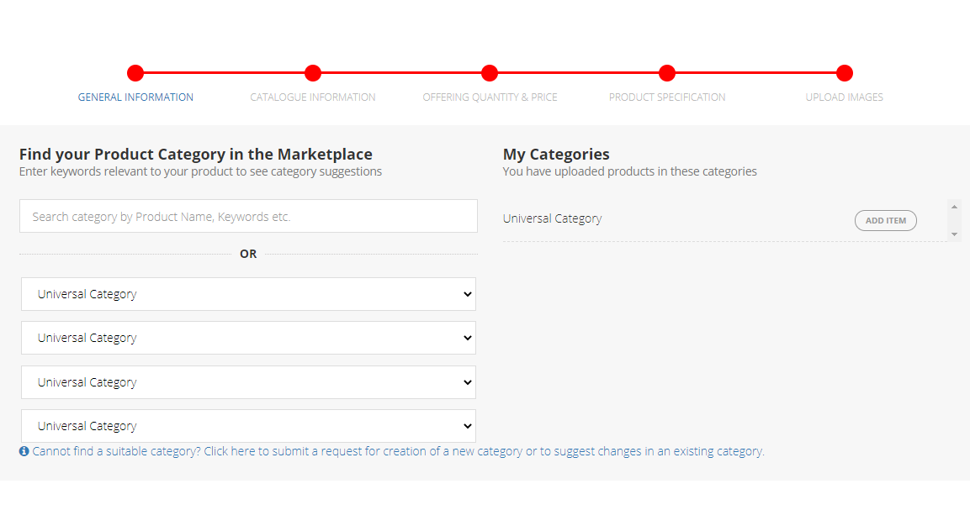
Without changing anything in the below mentioned fields , scroll down.

Slide 8
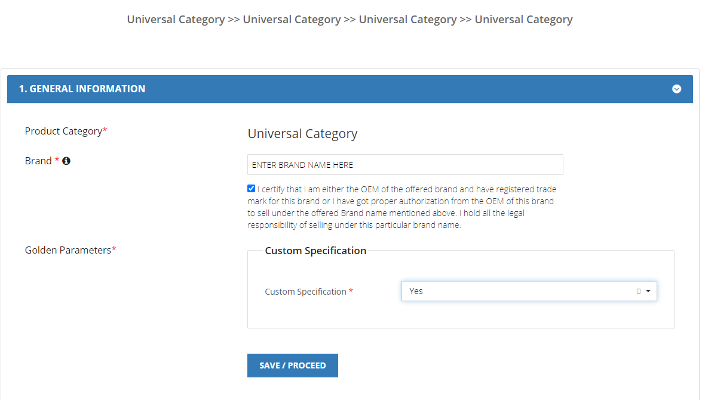
Enter Brand name, Check the undertaking and custom specification.

Slide 9
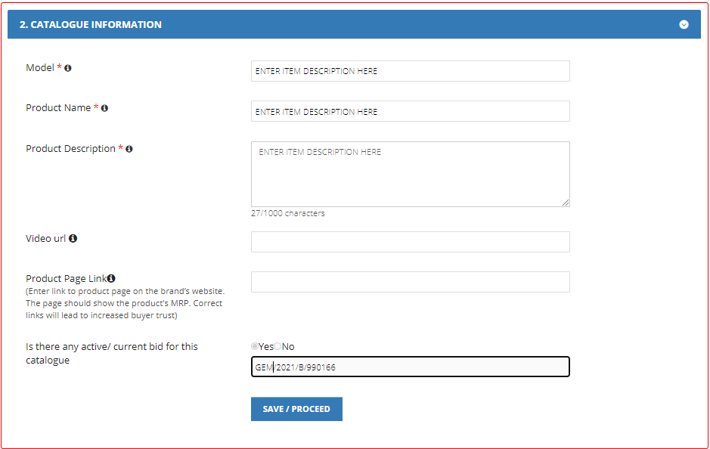
Enter Product description and GeM Bid No

Slide 10
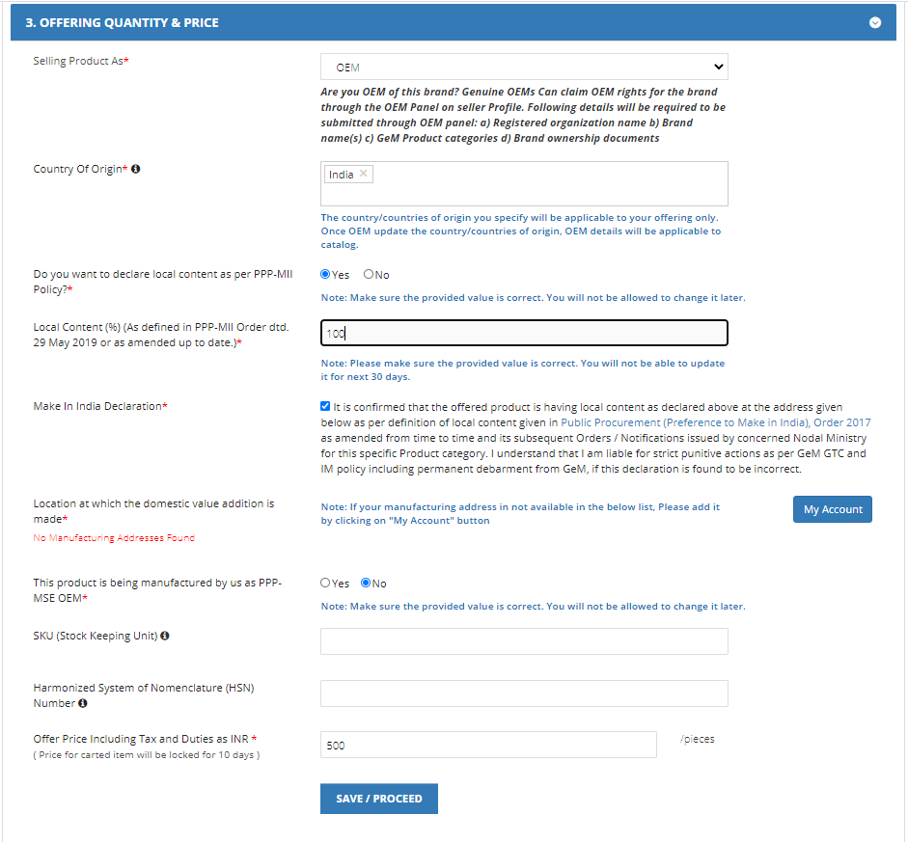
Price shall be final landed cost inclusive of GST

Slide 11
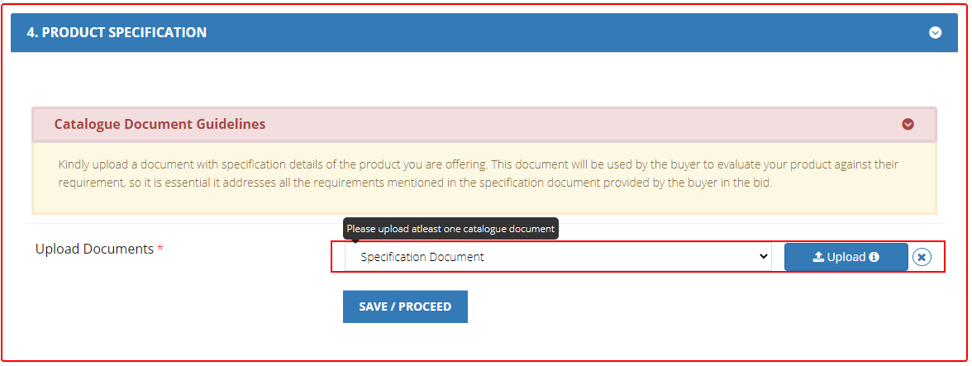
Upload the documents for the catalogue.

Slide 12
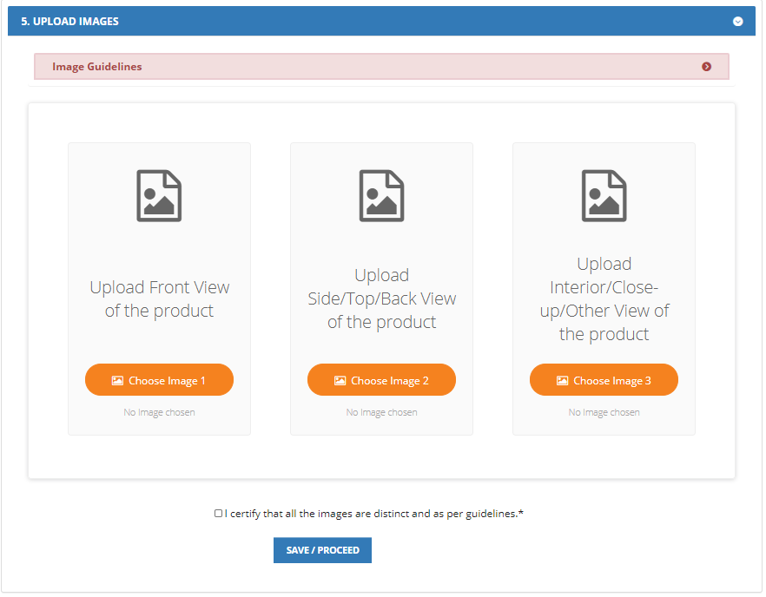
Upload three distinct images of the product.

Slide 13
Published item will appear here for selection.
Select the item.
Confirm Quantity, Final price
Upload mandatory documents and submit the bid.

